Slide 1
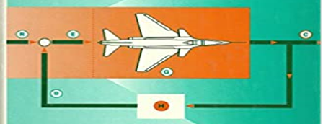
LINEAR CONTROL SYSTEM EE-324 Credit-Hours: 3+1
Dr. Wazir Muhammad
Electrical Engineering Department
BUET, Khuzdar

Slide 2
First Week | Modeling of electrical, mechanical and biological control systems, Open and closed-loop systems
Second Week | Block diagrams, Second order systems, Step and impulse response, Performance criteria, Steady state error.
Third Week | Sensitivity, s-plane system stability.
Fourth Week | Test-1
Fifth Week | Analysis and design with the root loci method.
Sixth week | Frequency domain analysis,
Seventh week | Bode plots,
Eight week | Nyquist criterion,
Ninth week | gain and phase margins,
Tenth week | Nichols charts.
Eleventh week | Test-2
Twelfth week | The State-space method
Thirteenth week | state equations,
Fourteenth week | flow graphs, stability
Sixteenth week | compensation techniques.

Slide 3
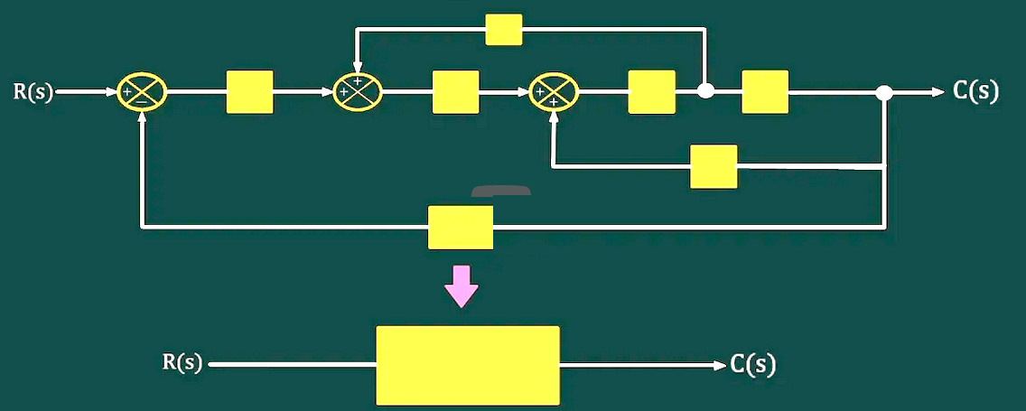
BLOCK DIAGRAM REPRESENTATION

Slide 4
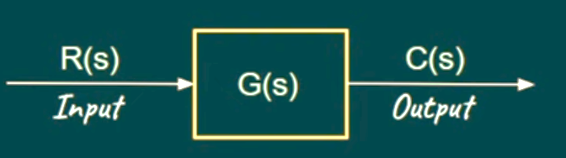
BLOCK DIAGRAM
Block Diagrams are pictorial representation of a Control System.
Block Diagram Representation is used to build a mathematical model of a Control System which can be simulated on a computer.
Block diagram Representation is used to calculate the overall transfer function of the system.
ELEMENTS OF A BLOCK DIAGRAM
The Signal into the Block is called as an Input.
The Signal out of the Block is called as an Output
The Block itself is called as a Transfer Function OR Gain.

Slide 5
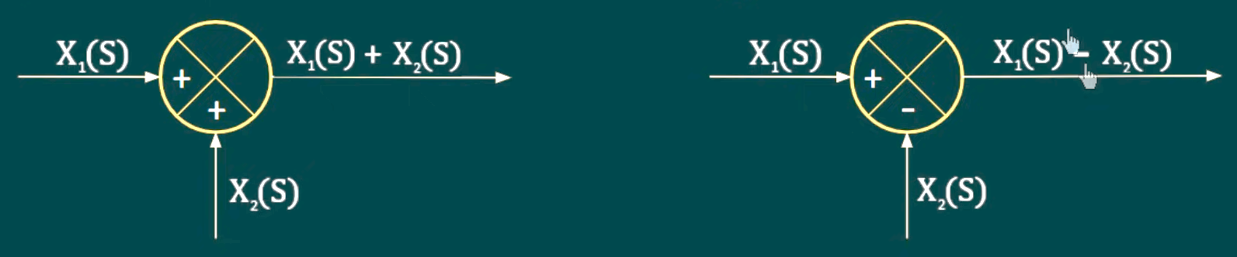
Summing Point OR Adder
A Summing Point/Summing Junction in a block diagram represents the dynamic summation of two or more signals.

Slide 6
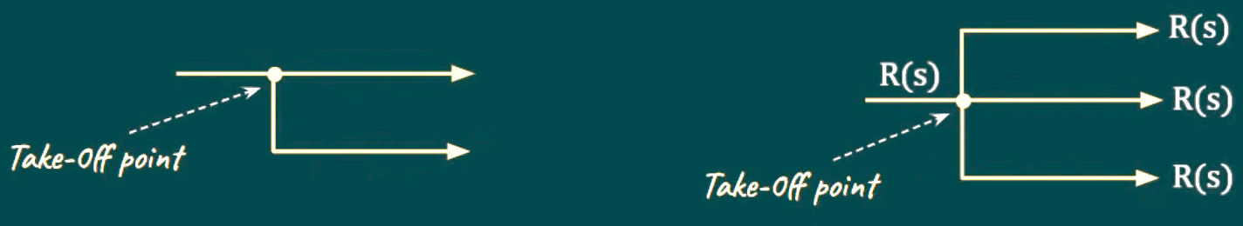
Take-Off-Point/Pick-Off Point/Branch Point/Distributed Point
Take-off point a block diagram represents a point where the signal branches are distributed and goes to the other blocks or a summing points.

Slide 7
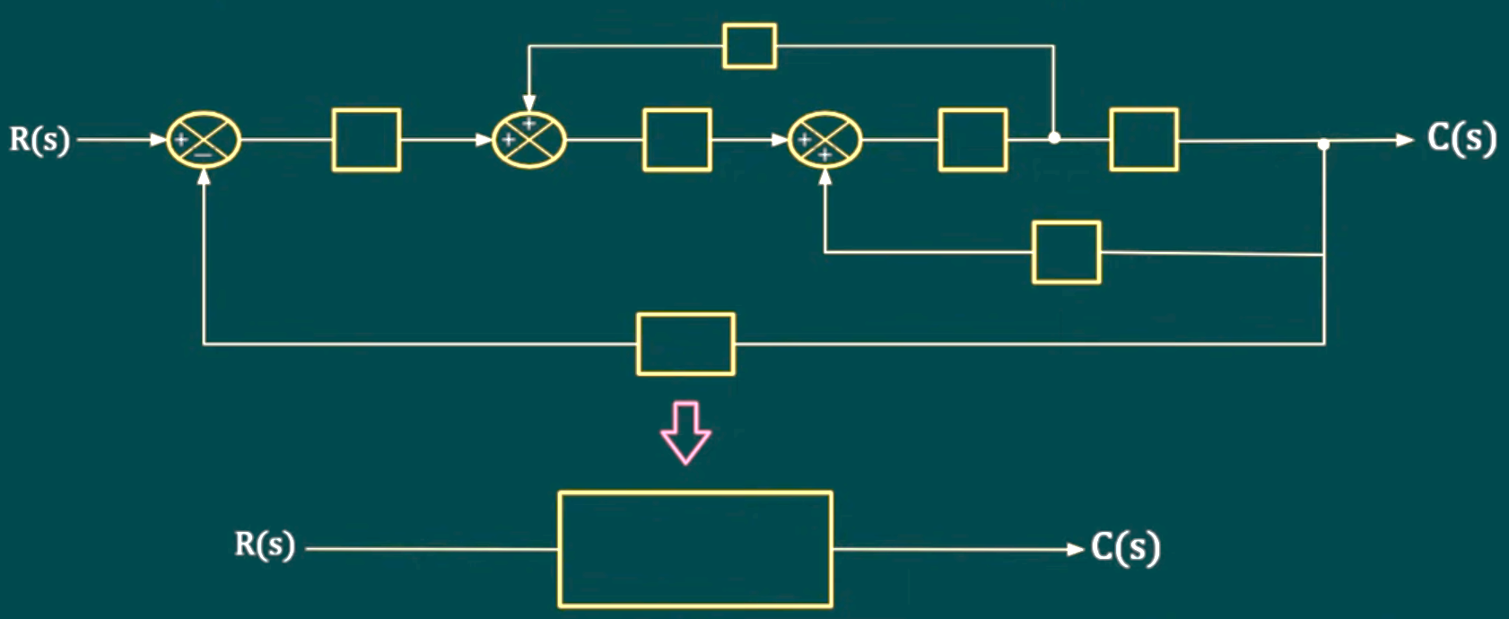
Reduction of Multiple Subsystems
In order to calculate the output w.r.t any given input, we need the overall transfer function of the system.
When the system is complex (having multiple subsystems), we need to reduce the complex block diagram representation into a single block.

Slide 8
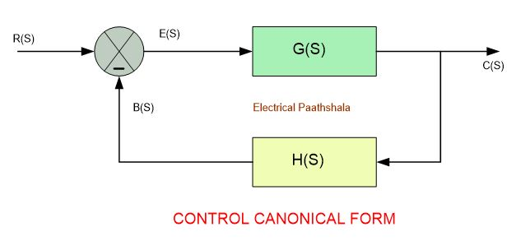
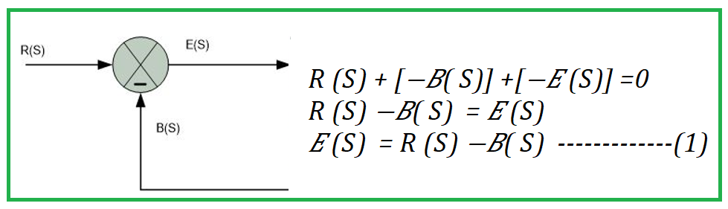
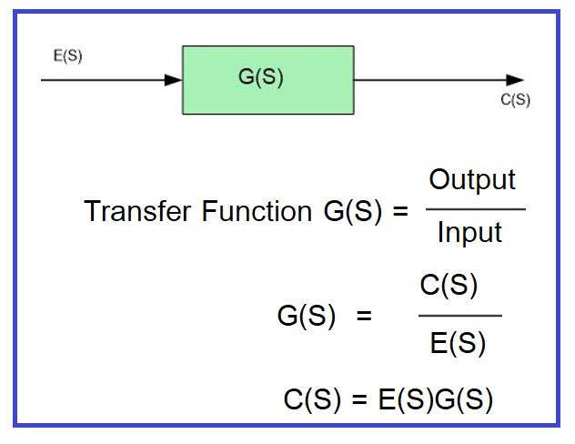
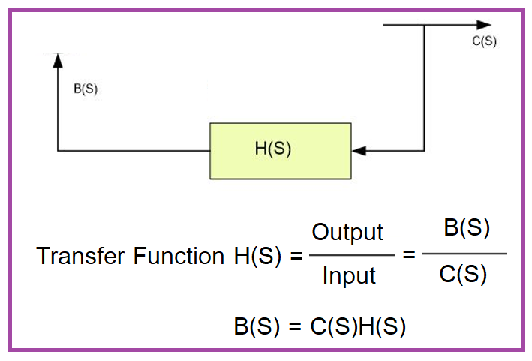
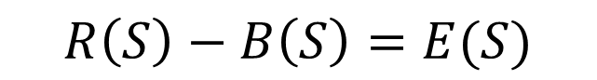
BLOCK DIAGRAM REDUCTION
$$R\left(S\right)+\left[−B\left(S\right)\right]−E\left(S\right)=0$$
$$R\left(S\right)−B\left(S\right)=E(S)$$
$$E\left(S\right)=R\left(S\right)−B\left(S\right) −−−−−−−(1)$$
$$C\left(S\right)=E\left(S\right)G\left(S\right)−−−−−−−−−−(2)$$
$$B\left(S\right)=C\left(S\right)H\left(S\right)−−−−−−−−−−(3)$$

Slide 9
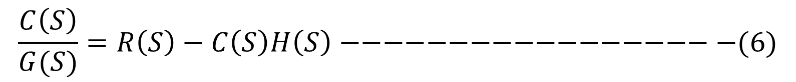
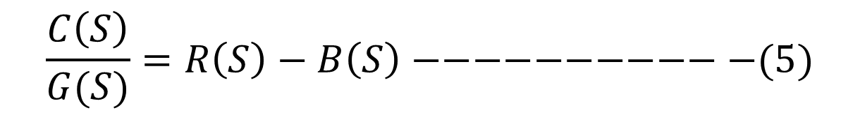
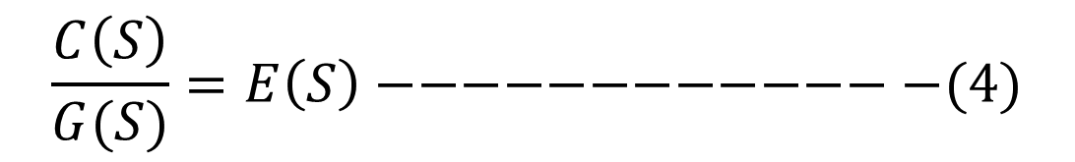
BLOCK DIAGRAM REDUCTION
$$E\left(S\right)=R\left(S\right)−B\left(S\right) −−−−−−−(1)$$
$$C\left(S\right)=E\left(S\right)G\left(S\right)−−−−−−−−−−(2)$$
$$B\left(S\right)=C\left(S\right)H\left(S\right)−−−−−−−−−−(3)$$
From equation (2)
$$\frac{C\left(S\right)}{G(S)}=E\left(S\right)−−−−−−−−−−−−−(4)$$
Put the value of E(S) in Equation (4)
$$\frac{C\left(S\right)}{G(S)}=R\left(S\right)−B\left(S\right)−−−−−−−−−−−(5)$$
Put the value of B(S) in Equation (5)
$$\frac{C\left(S\right)}{G(S)}=R\left(S\right)−C\left(S\right)H\left(S\right)−−−−−−−−−−−−−−−−−−(6)$$

Slide 10
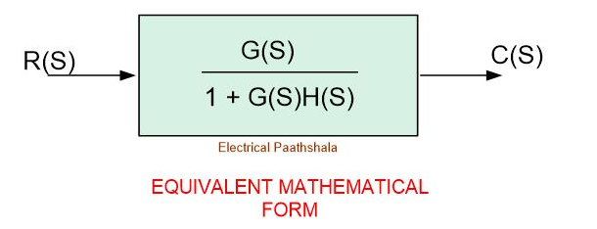
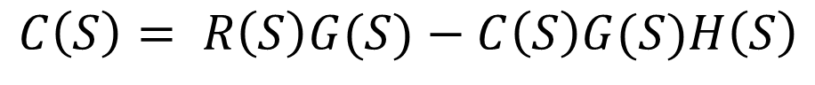
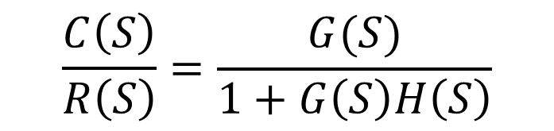
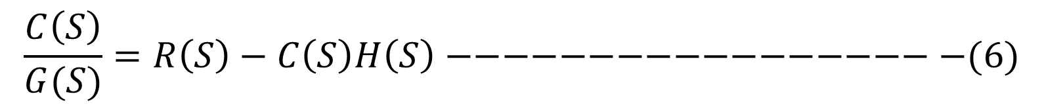
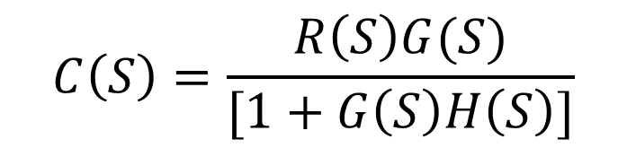
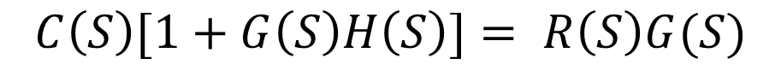
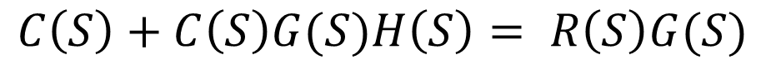
BLOCK DIAGRAM REDUCTION
$$\frac{C\left(S\right)}{G(S)}=R\left(S\right)−C\left(S\right)H\left(S\right)−−−−−−−−−−−−−−−−−−(6)$$
$$C\left(S\right)= R\left(S\right)G(S)−C\left(S\right)G(S)H\left(S\right)$$
$$C\left(S\right)+C\left(S\right)G(S)H\left(S\right)= R\left(S\right)G(S)$$
$$C\left(S\right)[1+G\left(S\right)H\left(S\right)]= R\left(S\right)G(S)$$
$$C\left(S\right)=\frac{R\left(S\right)G(S)}{[1+G\left(S\right)H\left(S\right)]}$$
$$\frac{C\left(S\right)}{R\left(S\right)}=\frac{G(S)}{1+G\left(S\right)H\left(S\right)}$$

Slide 11
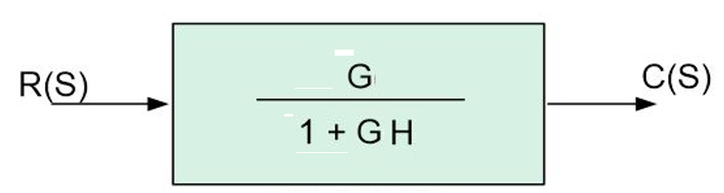
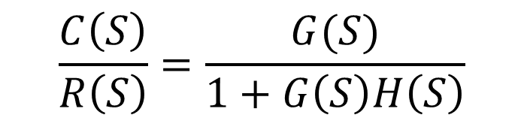

BLOCK DIAGRAM REDUCTION
$$\frac{C\left(S\right)}{R\left(S\right)}=\frac{G(S)}{1+G\left(S\right)H\left(S\right)}$$
$$For simplicity$$
$$TF=\frac{G}{1+GH}$$

Slide 12
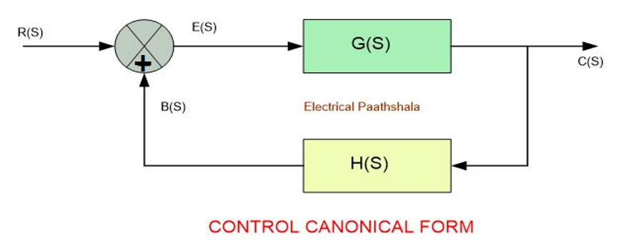
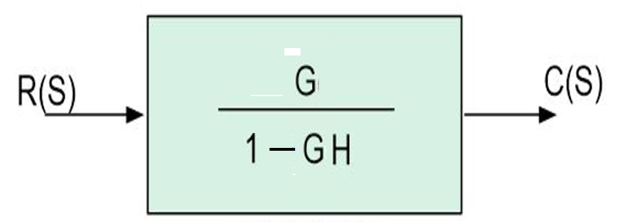
BLOCK DIAGRAM REDUCTION

Slide 13
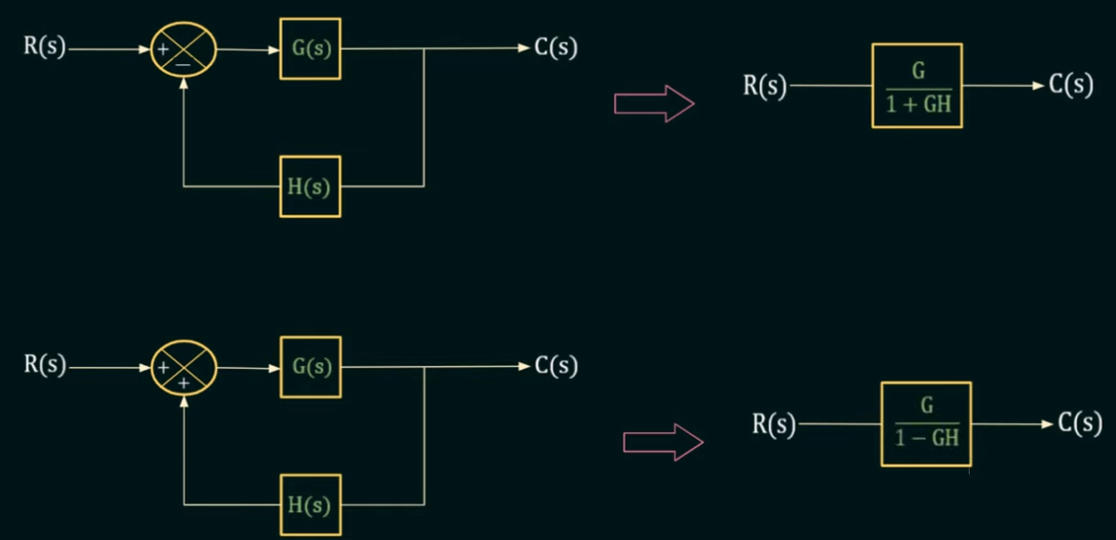

RULE-1: Representation of Closed Loop System
$$Transfer Function OR Gain=\frac{Output}{Input}$$

Slide 14
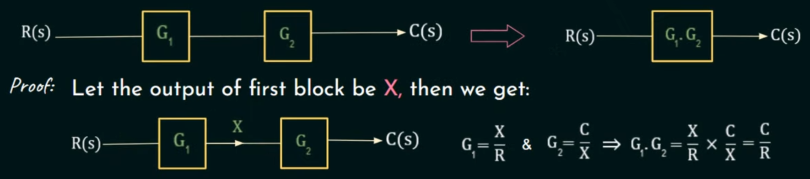
RULE-2: When Blocks are Connected in Series (Cascaded), their Gains are Multiplied

Slide 15
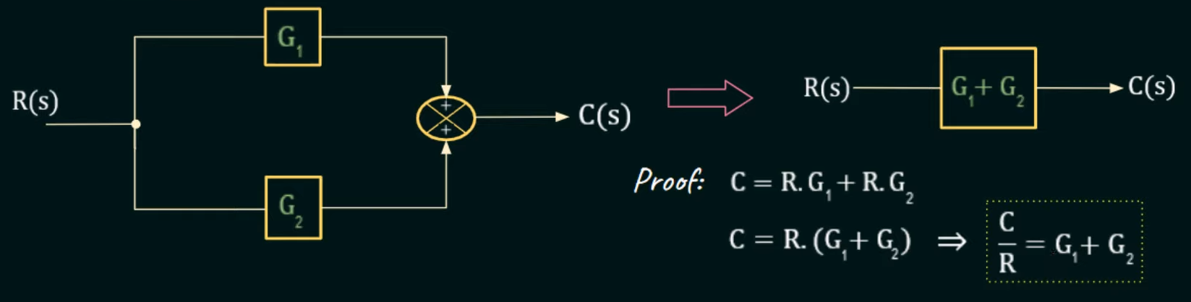
RULE-3: When Blocks are Connected in Parallel, their individual Gains are Added

Slide 16
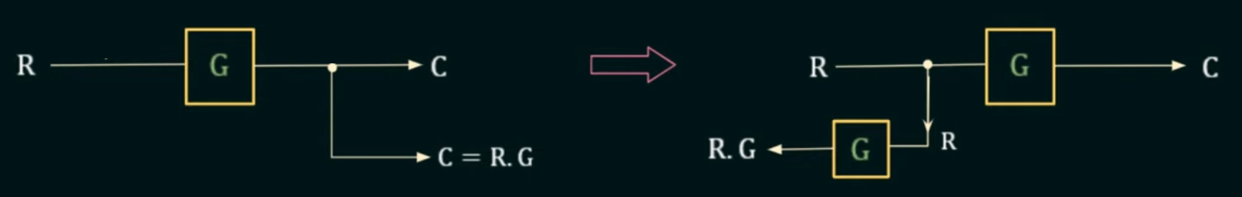
RULE-4: Shifting a take-off Point Before a Block
The changes to be made in the block diagram in moving the take-off point before the block and original block diagram is shown in below.
The output obtained after shifting the take-off point before a block is similar to the original block diagram output (But Multiplied by G).
Original Block
Shift a take-off Point Before a Block

Slide 17
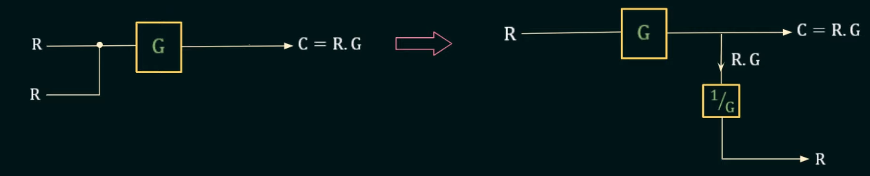
RULE-5: Shifting a take-off Point After a Block
The changes to be made in the block diagram in moving the take-off point after the block and original block diagram is shown in below.
The output obtained after shifting the take-off point after a block is similar to the original block diagram output (But divided G).

Slide 18
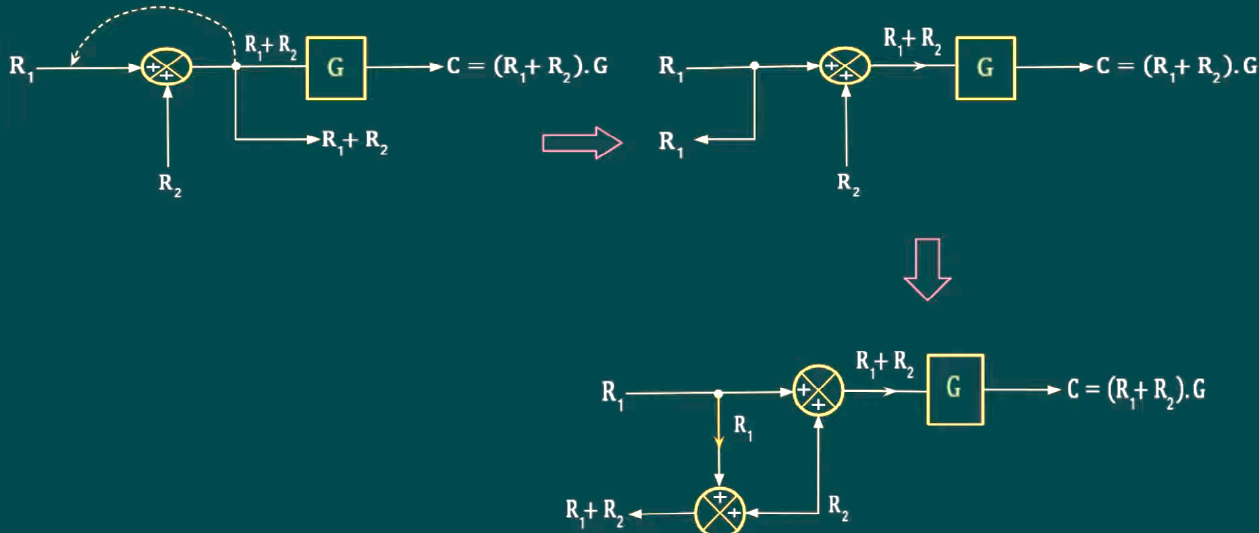
RULE-6: Shifting a take-off Point Before an Adder
If we want to shift a take-off point before an adder, than we can add more one adder in the block.

Slide 19
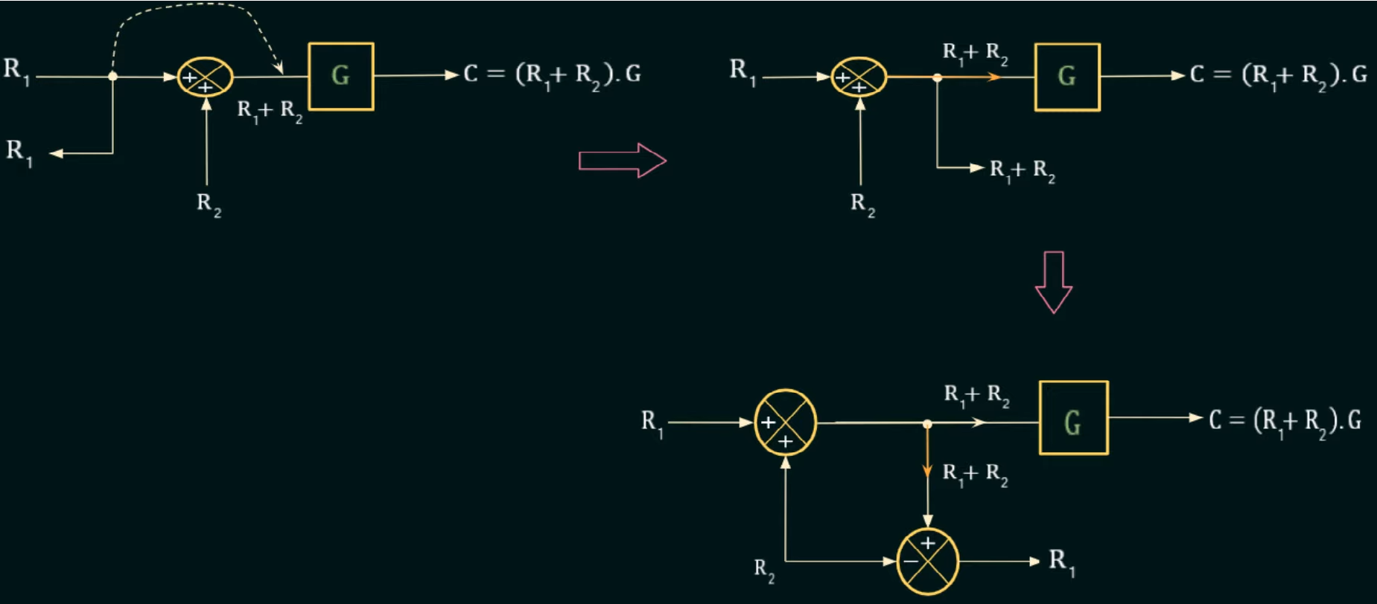
RULE-7: Shifting a take-off Point After an Adder
If we want to shift a take-off point After an adder, then we can add more one subtractor in the block.

Slide 20
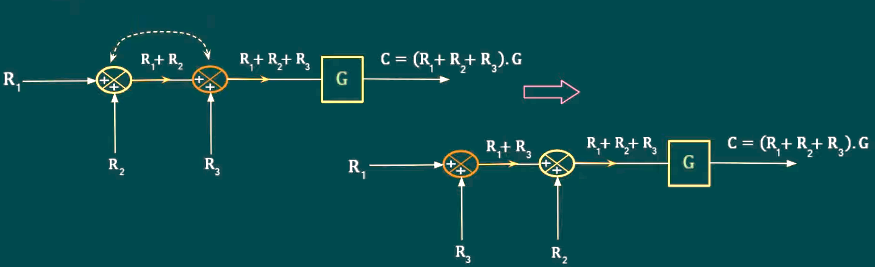
RULE-8: Rearrangement of Adders
In this block diagram connected two adders are side by side. The output of both block diagram is same.

Slide 21
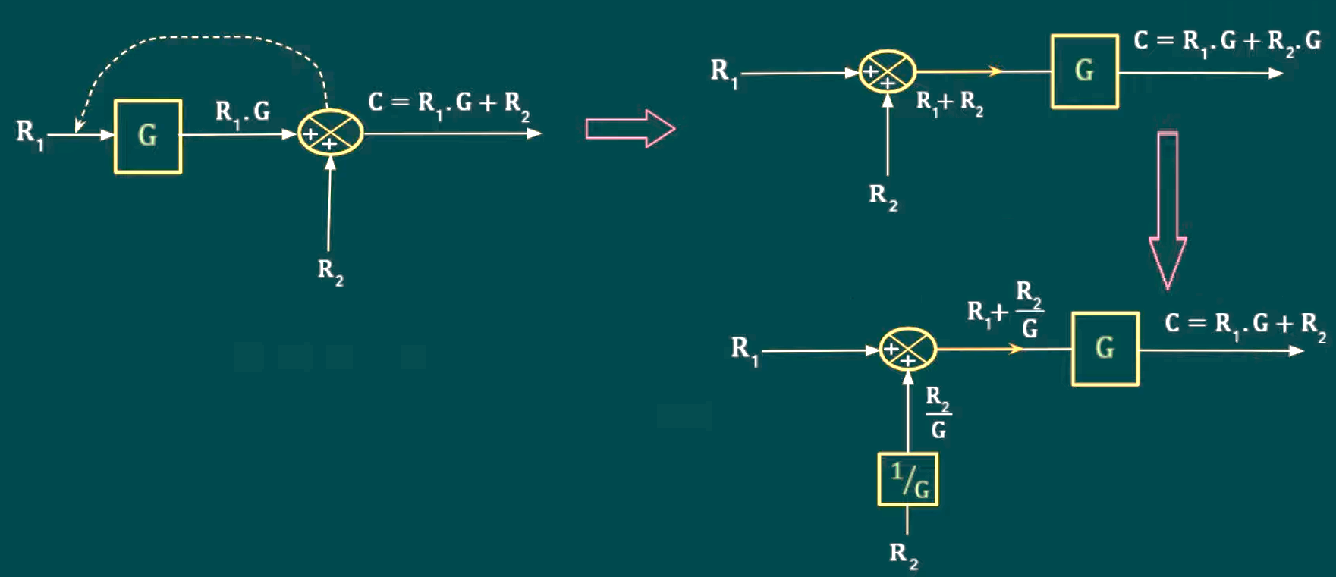
RULE-9: Shifting an Adder Before a Block
If we want to Shift an Adder before a Block, we divide the Gain (G) or TF of Original Block with Input of R₂

Slide 22
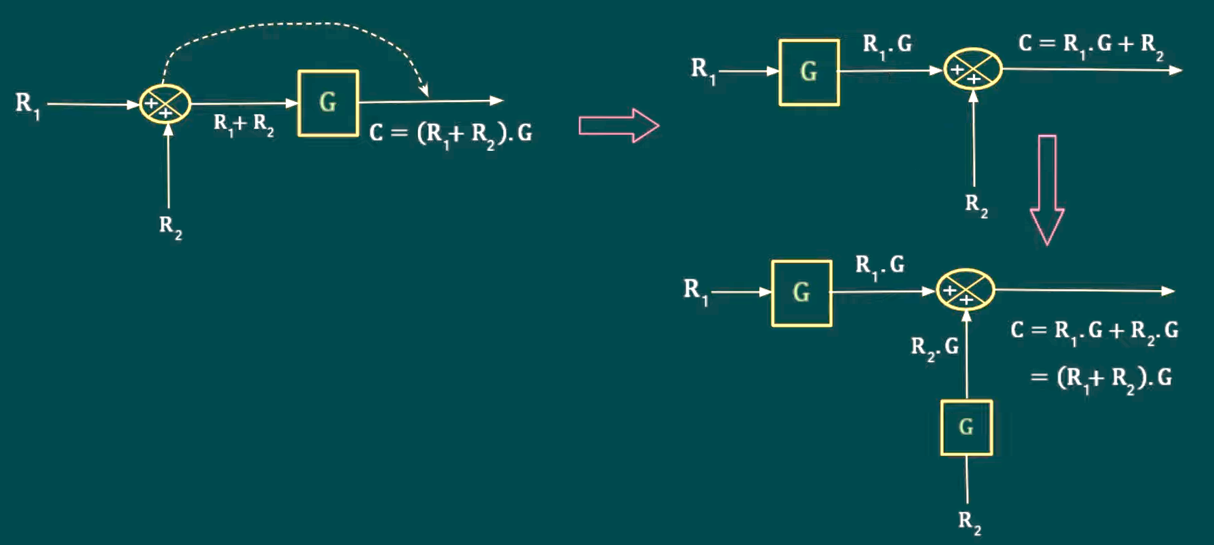
RULE-10: Shifting an Adder After a Block
If we want to Shift an Adder after a Block, we multiply the Gain (G) or TF of Original Block with Input of R₂

Slide 23
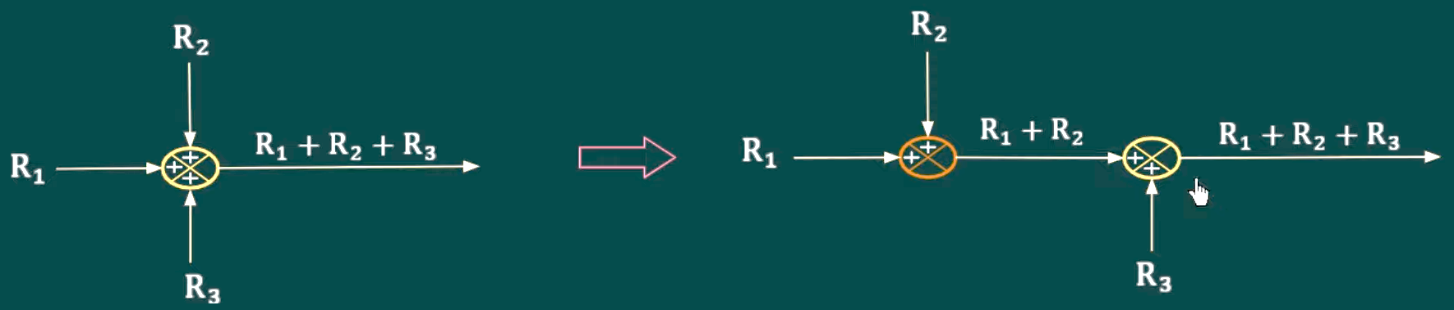
RULE-11: Splitting of a 3 Input Adder into a 2 Input Adder

Slide 24
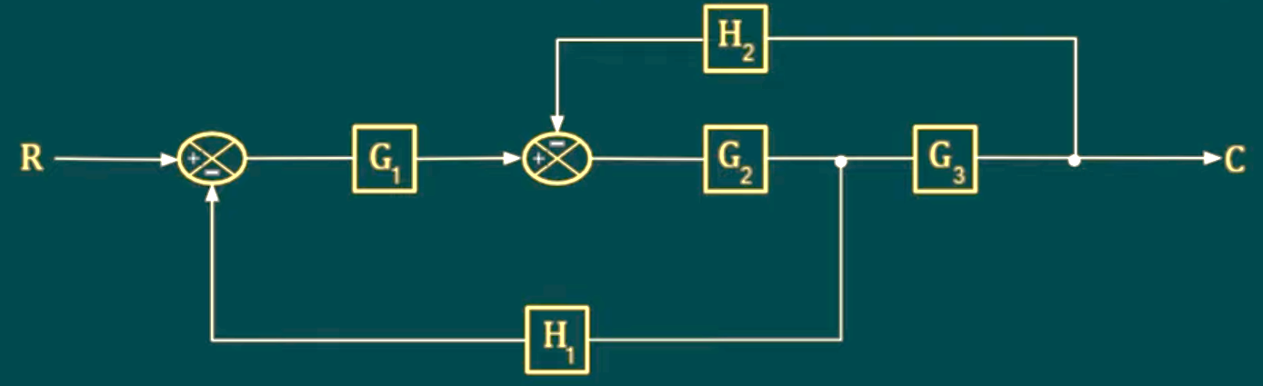
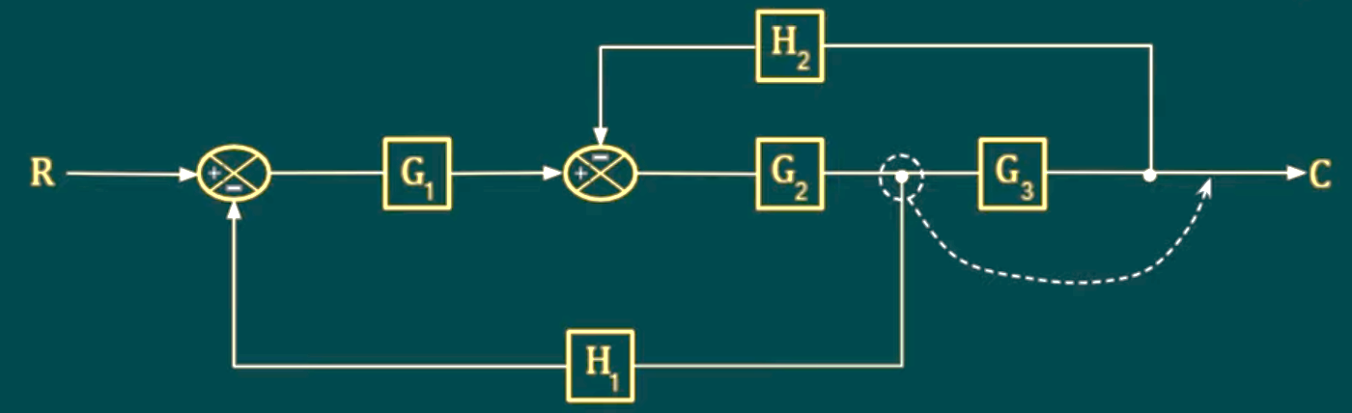
Example: Using Block Diagram Reduction, find the Transfer Function of the system whose block diagram is shown in the below figure.
We shift take off point after G₃ block than G₂ and G₃ in Series.

Slide 25
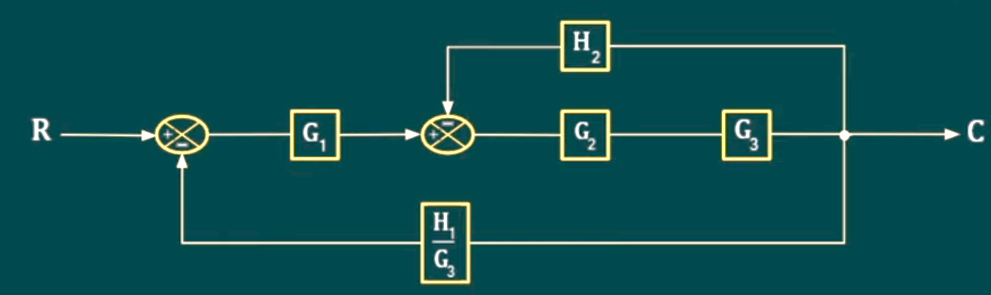
Example: Using Block Diagram Reduction, find the Transfer Function of the system whose block diagram is shown in the below figure.
Rule 5 says that if we shift the take-off point after the block, we can divide it by H₁/G₃

Slide 26
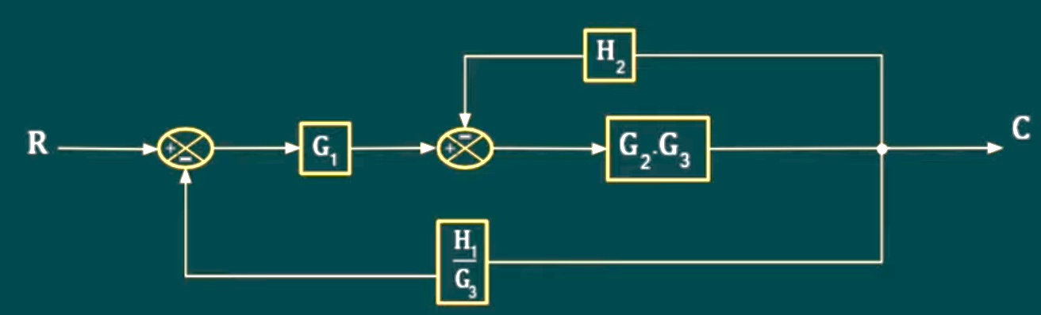
Example: Using Block Diagram Reduction, find the Transfer Function of the system whose block diagram is shown in the below figure.
Rule 2: G₂ and G₃ in Series, so we can multiply both Gains.

Slide 27
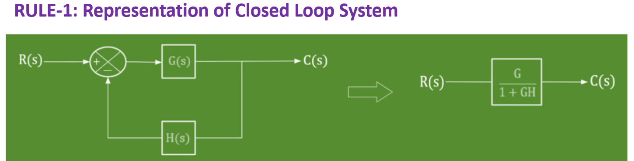
Example: Using Block Diagram Reduction, find the Transfer Function of the system whose block diagram is shown in the below figure.
Rule 1: Closed Loop with Negative Feedback.

Slide 28
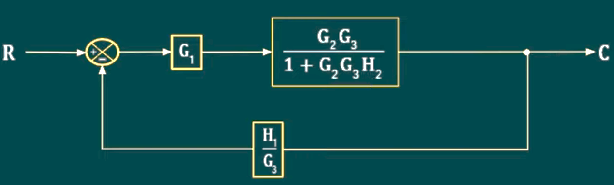
Example: Using Block Diagram Reduction, find the Transfer Function of the system whose block diagram is shown in the below figure.
Rule 1: Closed Loop with Negative Feedback.

Slide 29
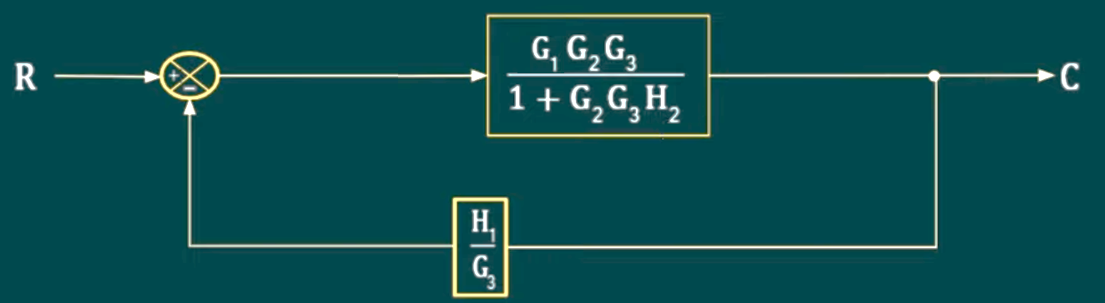
Example: Using Block Diagram Reduction, find the Transfer Function of the system whose block diagram is shown in the below figure.
Rule 2: G₁ and other block in Series, so we can multiply both Gains.

Slide 30
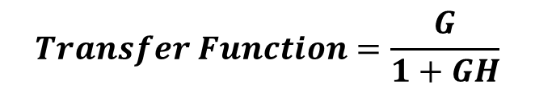
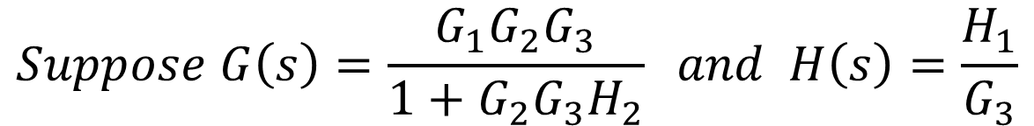
Example: Using Block Diagram Reduction, find the Transfer Function of the system whose block diagram is shown in the below figure.
$$Suppose G\left(s\right)=\frac{G_{1}G_{2}G_{3}}{1+G_{2}G_{3}H_{2}} and H\left(s\right)=\frac{H_{1}}{G_{3}}$$
$$Transfer Function=\frac{G}{1+GH}$$

Slide 31
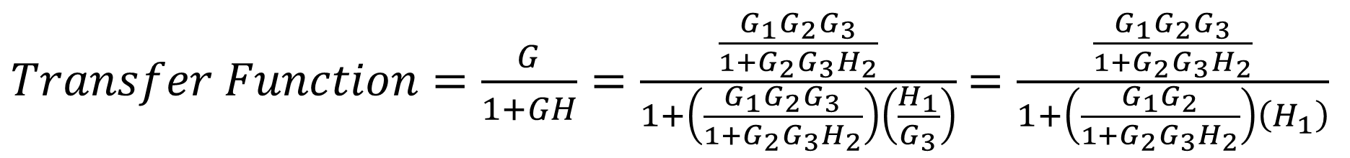
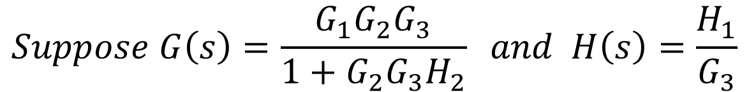
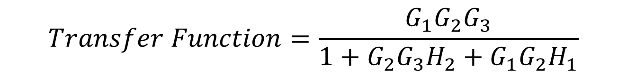
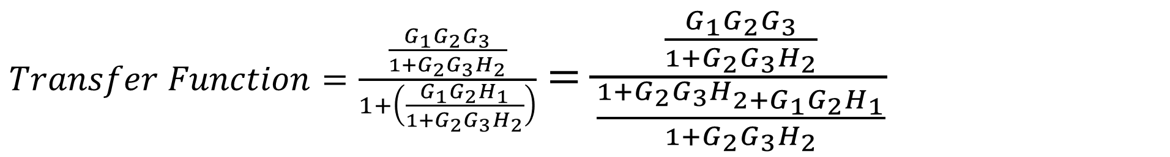
Example: Using Block Diagram Reduction, find the Transfer Function of the system whose block diagram is shown in the below figure.
$$Suppose G\left(s\right)=\frac{G_{1}G_{2}G_{3}}{1+G_{2}G_{3}H_{2}} and H\left(s\right)=\frac{H_{1}}{G_{3}}$$
$Transfer Function=\frac{G}{1+GH}=\frac{\frac{G_{1}G_{2}G_{3}}{1+G_{2}G_{3}H_{2}}}{1+\left(\frac{G_{1}G_{2}G_{3}}{1+G_{2}G_{3}H_{2}}\right)\left(\frac{H_{1}}{G_{3}}\right)}$ $=\frac{\frac{G_{1}G_{2}G_{3}}{1+G_{2}G_{3}H_{2}}}{1+\left(\frac{G_{1}G_{2}}{1+G_{2}G_{3}H_{2}}\right)\left(H_{1}\right)}$
$Transfer Function=\frac{\frac{G_{1}G_{2}G_{3}}{1+G_{2}G_{3}H_{2}}}{1+\left(\frac{G_{1}G_{2}H_{1}}{1+G_{2}G_{3}H_{2}}\right)}$ $=\frac{\frac{G_{1}G_{2}G_{3}}{1+G_{2}G_{3}H_{2}}}{\frac{1+G_{2}G_{3}H_{2+G_{1}G_{2}H_{1}}}{1+G_{2}G_{3}H_{2}}}$
$$Transfer Function=\frac{G_{1}G_{2}G_{3}}{1+G_{2}G_{3}H_{2}+G_{1}G_{2}H_{1}}$$

Slide 32
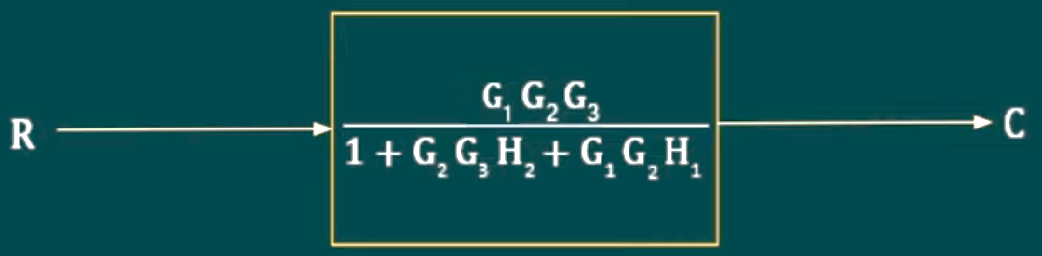


Example: Using Block Diagram Reduction, find the Transfer Function of the system whose block diagram is shown in the below figure.
$$Transfer Function=\frac{G_{1}G_{2}G_{3}}{1+G_{2}G_{3}H_{2}+G_{1}G_{2}H_{1}}$$

Slide 33



Example: Using the block diagram reduction technique, determine the closed loop transfer function C(s)/R(s).
Rule 11: Splitting the 3 Input Adder into 2 Input Adder

Slide 34
Example: Using the block diagram reduction technique, determine the closed loop transfer function C(s)/R(s).

Slide 35



$$G\left(s\right)=G_{2}and H\left(s\right)=H_{2}$$
$$TF=\frac{G}{1+GH}=\frac{G_{2}}{1+G_{2}H_{2}}$$
Rule 1: Closed Loop with Negative Feedback.

Slide 36
$$G\left(s\right)=G_{2}and H\left(s\right)=H_{2}$$
$$TF=\frac{G}{1+GH}=\frac{G_{2}}{1+G_{2}H_{2}}$$
Rule 1: Closed Loop with Negative Feedback.

Slide 37



$$G\left(s\right)=G_{2}and H\left(s\right)=H_{2}$$
$$TF=\frac{G}{1+GH}=\frac{G_{2}}{1+G_{2}H_{2}}$$

Slide 38

Shifting the Adder after block G₁

Slide 39
Shifting the Adder after block G₁

Slide 40
RULE-10: Shifting an Adder After a Block
If we want to Shift an Adder after a Block, we multiply the Gain (G) or TF of Original Block with Input of R₂

Slide 41


Slide 42
RULE-8: Rearrangement of Adders
In this block diagram connected two adders are side by side. The output of both block diagram is same.

Slide 43

Rearranging of adders

Slide 44

G₁ and H₁ are in Series

Slide 45


Closed Loop with Negative Feedback
$$G\left(s\right)=\frac{G_{2}}{1+G_{2}H_{2}} And H\left(s\right)=G_{1}H_{1}$$
$$TF=\frac{G}{1+GH}=\frac{\frac{G_{2}}{1+G_{2}H_{2}}}{1+{\left(\frac{G_{2}}{1+G_{2}H_{2}}\right)G}_{1}H_{1}}$$

Slide 46



$TF=\frac{G}{1+GH}=\frac{\frac{G_{2}}{1+G_{2}H_{2}}}{1+{\left(\frac{G_{2}}{1+G_{2}H_{2}}\right)G}_{1}H_{1}}$ $=\frac{\frac{G_{2}}{1+G_{2}H_{2}}}{1+\frac{G_{2}G_{1}H_{1}}{1+G_{2}H_{2}}}$
$$TF=\frac{\frac{G_{2}}{1+G_{2}H_{2}}}{\frac{{1+G_{2}H_{2}+G}_{2}G_{1}H_{1}}{1+G_{2}H_{2}}}=\frac{G_{2}}{{1+G_{2}H_{2}+G}_{2}G_{1}H_{1}}$$

Slide 47

Closed Loop with Negative Feedback

Slide 48

If Gains and Block in Parallel, we Add
Gain is nothing, simply means 1

Slide 49

If Blocks in Series, we multiply

Slide 50


Nothing means 1
Adding the gains of block in parallel

Slide 51

Two blocks are in Series

Slide 52

Gains and blocks are in Parallel
Nothing means 1

Slide 53



Slide 54


Slide 55


